Slide 1


EAST WEST INSTITUTE OF TECHNOLOGY DEPARTMENT OF INFORMATION SCIENCE AND ENGINEERING
Final Project Presentation on
CURIS : The Disease Predictor
PRESENTED BY : | GUIDED BY :
ARCHIT SHARMA (1EW17IS010) KRISHNAM CHATURVEDI (1EW17IS048) ARGHADEEP BANERJEE (1EW17IS011) | Mrs SHRUTHI T V ASST PROF, DEPT OF ISE,EWIT

Slide 2
CONTENTS
Introduction
Abstract
Objectives
Literature Survey
Existing System & its Disadvantages
Proposed System & Architecture
Modules & Methodology
System Design(Use Case Diagram)
Implementation
Testing
Results
Conclusion
References

Slide 3
INTRODUCTION
Medical facilities need to be advanced so that better decisions for patient diagnosis and treatment options can be made. Machine learning in healthcare aids the humans to process huge and complex medical datasets and then analyze them into clinical insights. This then can further be used by physicians in providing medical care. Hence machine learning when implemented in healthcare can leads to increased patient satisfaction. Different functionalities of machine learning is implemented in healthcare in a single system. Instead of diagnosis, when a disease prediction is implemented using certain machine learning predictive algorithms then healthcare can be made smart. Some cases can occur when early diagnosis of a disease is not within reach. Hence disease prediction can be effectively implemented. As widely said “Prevention is better than cure”, prediction of diseases and epidemic outbreak would lead to an early prevention of an occurrence of a disease.

Slide 4
ABSTRACT
CURIS: The disease prediction system is based on predictive modeling which predicts the diseases of the user based on the symptoms. The disease prediction system has three users such as doctor, patient and admin. Each users are authenticated by the system. The system allows the patient to give symptoms. On the basis of the given symptoms, the system analyses the symptoms runs multiple algorithms and then gives the probability of the occurrence of a disease as an output. Disease prediction is done by using classification algorithms, the classifier calculates the probability of the disease and adds the accuracy score. The system also suggests doctors for predicted disease, where the user can consult with the doctor at their convenience by sitting at home. The chatbox functionality will help the patients to take early measures before an appointment.

Slide 5
OBJECTIVES
To make healthcare facility easy for the patients and take necessary actions without stepping out unnecessarily.
To deliver a user friendly system via which every patient can do the following:
Check the probability of a disease from which they might be suffering by providing the symptoms they are facing.
Schedule an appointment with the doctor.
Take necessary precautions in order to lessen the impact caused.

Slide 6
LITERATURE SURVEY
“Prediction of Cardiovascular Disease Using Machine Learning Algorithms” (2018)
This paper contributes the correlative application and analysis of distinct machine learning algorithms in the R software which gives an immediate mechanism for the user to use the machine learning algorithms in R software for forecasting the cardiovascular diseases.
The results shows that the system has great potential in predicting the heart disease risk level more accurately.
ID3 has some features like removing outliers, handling missing values and but there major disadvantage is to over-fitting. And it’s not so easy to implement as that of Naïve Bayes algorithm.

Slide 7
“Prediction of Heart Disease Using Machine Learning Algorithms” (2018)
In this paper, two supervised data mining algorithm was applied on the dataset to predict the possibilities of having heart disease of a patient, were analyzed with classification model namely Naïve Bayes Classifier and Decision tree classification.
The Decision tree model has predicted the heart disease patient with an accuracy level of 91% and Naïve Bayes classifier has predicted heart disease patient with an accuracy level of 87%.

Slide 8
“A Proposed Model for Lifestyle Disease Predict Vectorion Using Support Machine” (2018)
This study aims to understand support vector machine and use it to predict lifestyle diseases that an individual might be susceptible to.
In the existing system the info set is often little, for patients and diseases with specific conditions. These systems are principally designed for the additional prodigious diseases like cardiovascular disease, Cancer etc. The pre-selected characteristics could generally not satisfy the changes within the malady and its influencing factors that may lead to quality in results.
The main feature will be the machine learning, in which algorithm use are such as Naïve Bayes Algorithm, K-Nearest Algorithm, Decision Tree Algorithm, Random Forest Algorithm and Support Vector Machine, which will help us in getting accurate predictions

Slide 9
“Review of Medical Disease Symptoms Prediction Using Data Mining Technique”(2017)
In this paper evaluate the performance of medical disease prediction based on data mining technique.
Classification proceed based on classifier selection to medical disease data and propose a clustering based classifier selection method. In the method, many clusters are selected for a ensemble process. Then, the standard presentation of each classifier on selected clusters is calculated and the classifier with the best average performance is chosen to classify the given data.
Data Mining Technique : KNN Classifier , Rough Set Theory , SVM (Support Vector Machine)

Slide 10
“Disease Prediction Using Machine Learning” (2019) - Akash C. Jamgade, Prof. S. D. Zade
In this paper, the structured and unstructured data in healthcare fields is combined that lets to assess the risk of disease. The approach of the latent factor model for reconstructing the missing data in medical records which are collected from the hospital. And by using statistical knowledge, it could determine the major chronic diseases in a particular region and in particular community. To handle structured data consult hospital experts to know useful features.
In the case of unstructured text data, selects the features automatically with the help of k-mean algorithm. A k-mean algorithm is proposed for both structured and unstructured data.

Slide 11
EXISTING SYSTEM
Implementation of ML technologies in health care as a part of prediction model helps doctors and patients to analyze the disease.
Prediction using the traditional disease risk model usually involves machine learning algorithm which compares the data to the diseases and in most cases the sub diseases falls under the same category.
The data sets includes the data of mostly the frequently occurring diseases like cardiac problems, diabetes, asthma, etc.
As we live in continuously evolving world, the symptoms of diseases also evolve over a course of time. Also most of the current systems make the users wait for long periods by making them answer lengthy questionnaires.

Slide 12
Disadvantages of Existing System
The sub diseases falls under the same category. So it becomes difficult to differentiate between diseases of the same category but of different types.
The data sets includes the data of mostly the frequently occurring diseases so it leaves out rare diseases or less occurring diseases.
No sorts of precautions available to patients in case they cannot immediately pay a visit to the doctors.

Slide 13
PROPOSED SYSTEM
The proposed system focuses on overcoming all the disadvantages of existing system. Proposed system predicts all diseases along with the sub diseases which occur in society. The system combines the results using multi classifier into subsets and increase the accuracy.
Different algorithms which increase the overall operational efficiency includes:
Decision Tree
Naïve Bayes

Slide 14
Fig: Sample Architecture

Slide 15
MODULE IMPLEMENTATION
Implementation of a system must be done step by step in order achieve the object of developed system. Identifying the modules makes it easier to work on developing the system.
In the proposed system, there are six modules that have been identified. These six modules are the six different features which put together will form a whole system. six modules that have been identified are :
● Input module
● Doctor
● User
● Admin
● Prediction system
● Output model

Slide 16
METHODOLOGY
When the user symptoms are received the symptoms are transferred to the trained model
The model consists of Decision Tree and Naïve Bayes algorithm in order to predict the output i.e. the predicted disease.
After successful completion of machine learning algorithms the disease predicted is displayed on the user screen with the probability of its occurrence.
The system also recommends the specialist doctors of the disease and platform where patient can text to doctor and take appointments as well as required safety precautions.

Slide 17
ALGORITHMS
Decision Tree Algorithm
Decision Tree algorithm belongs to the family of supervised learning algorithms. Unlike other supervised learning algorithms, the decision tree algorithm can be used for solving regression and classification problems too.
The goal of using a Decision Tree is to create a training model that can use to predict the class or value of the target variable by learning simple decision rules inferred from prior data(training data).
In Decision Trees, for predicting a class label for a record we start from the root of the tree. We compare the values of the root attribute with the record’s attribute. On the basis of comparison, we follow the branch corresponding to that value and jump to the next node.

Slide 18

Fig: Decision Tree

Slide 19
Naïve Bayes
Naïve Bayes classifiers are a collection of algorithms based on Bayes’ theorem. The dataset is divided into two parts namely Feature matrix and Response vector. Feature matrix contains all vectors(rows) of the dataset in which each vector consists of value of dependent features.
In Our data set, features are the symptoms such as ‘Fever’ , ’Cold’, ’Headache’ etc. Suppose vector contains the values of Class variable(prediction or the output) for each row of feature matrix in our dataset, the class variables are the diseases like ‘malaria’, ‘dengue’ etc. Bayes’ theorem will also find the probability of an event occurring and hence in our model it not only helps in predicting the disease but also gives the probability of occurrence of the disease.

Slide 20
SYSTEM TESTING
DEFINITION :Testing is the process of executing a program with the aim of finding errors. To make our software perform well it should be error-free. If testing is done successfully it will remove all the errors from the software.
● Unit Testing
It focuses on the smallest unit of software design. In this, we test an individual unit or group of interrelated units. It is often done by the programmer by using sample input and observing its corresponding outputs.
Example: a) In a program we are checking if loop, method or function is working fine
b) Misunderstood or incorrect, arithmetic precedence.

Slide 21
● Alpha Testing
This is a type of validation testing. It is a type of acceptance testing which is done before the product is released to customers. It is typically done by QA people.
Example: When software testing is performed internally within the organization.
● Beta Testing
The beta test is conducted at one or more customer sites by the end-user of the software. This version is released for a limited number of users for testing in a real-time environment
Example: When software testing is performed for the limited number of people

Slide 22
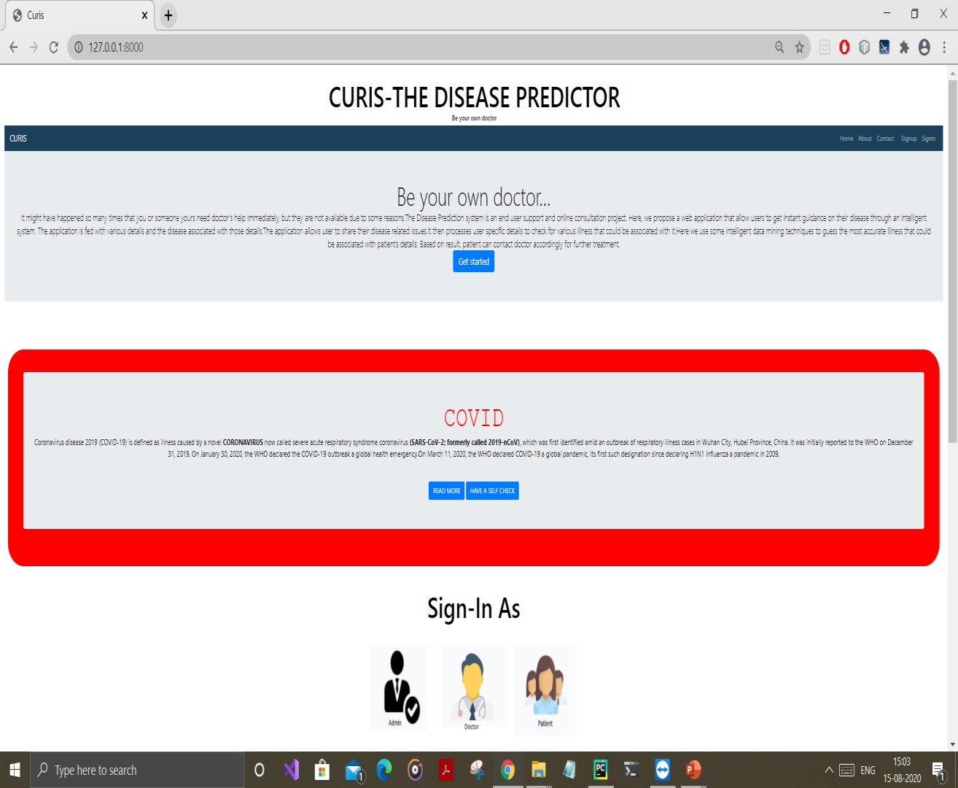
RESULTS
FIG: MAIN PAGE

Slide 23
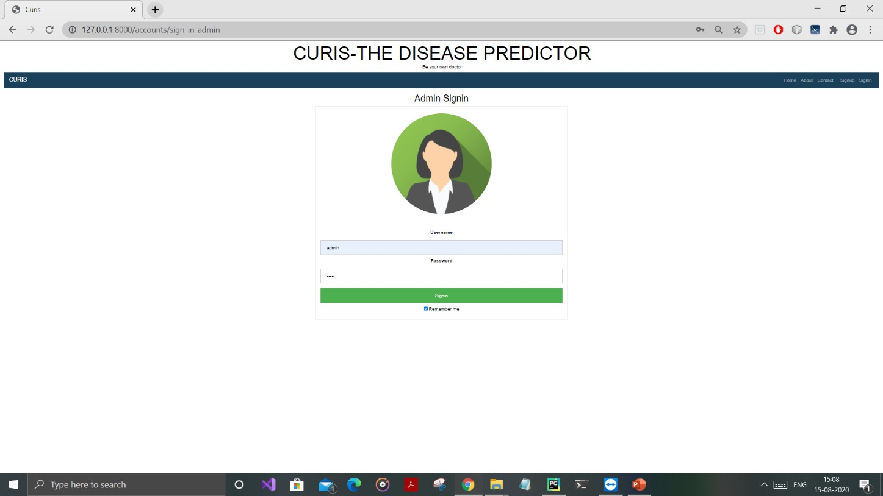
FIG : ADMIN PAGE

Slide 24
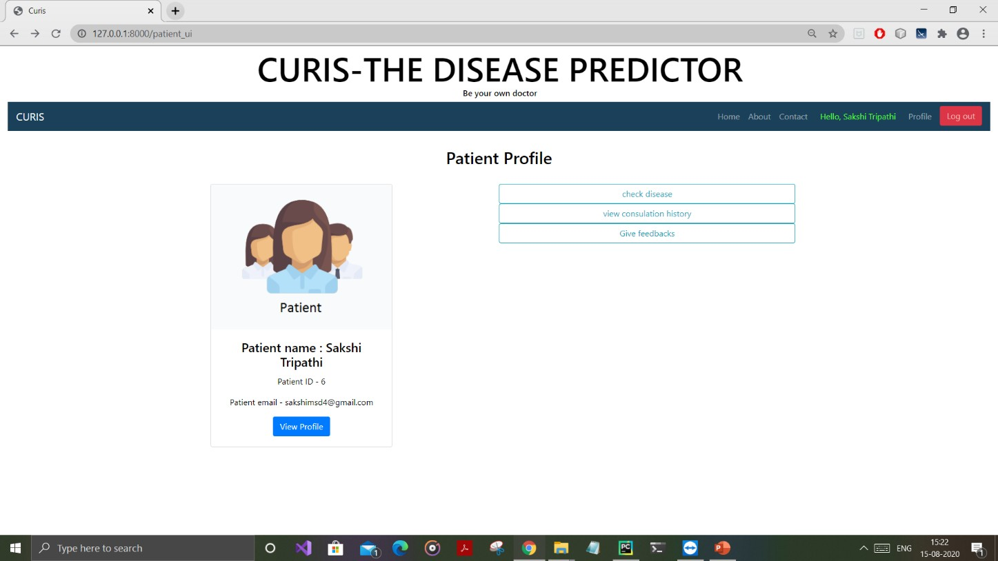
FIG: PATIENT PROFILE

Slide 25
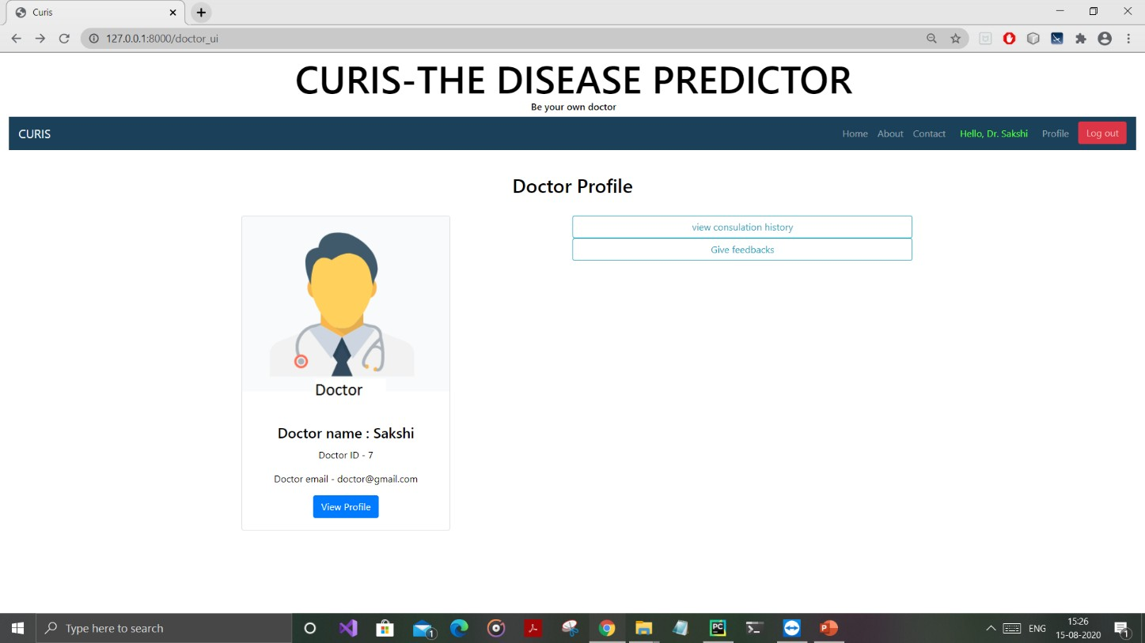
FIG: DOCTOR PROFILE

Slide 26
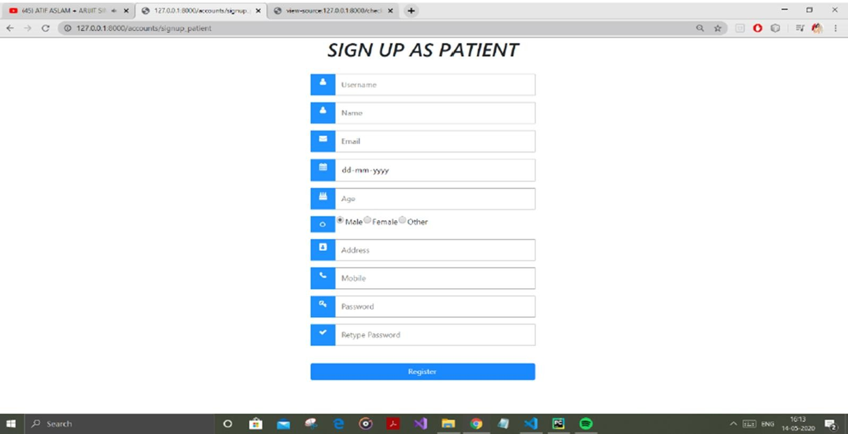
FIG: PATIENT REGISTRATION PAGE

Slide 27
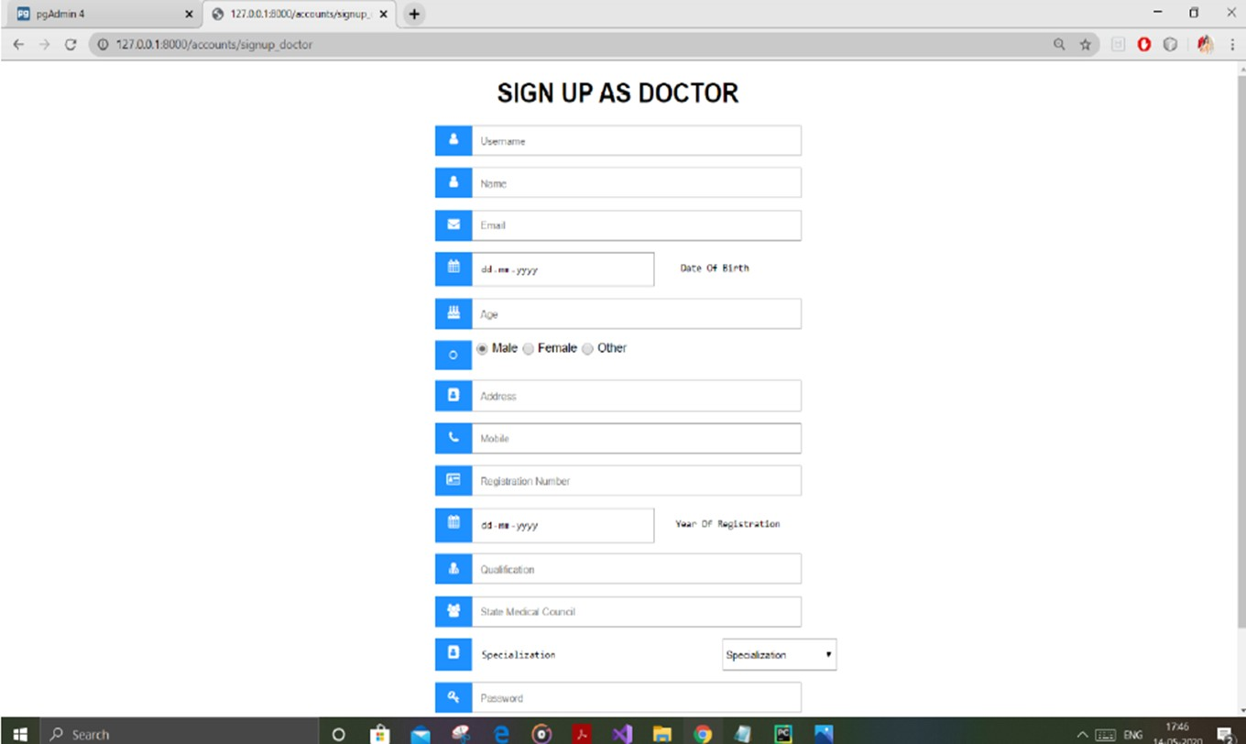
FIG: DOCTOR REGISTRATION PAGE

Slide 28
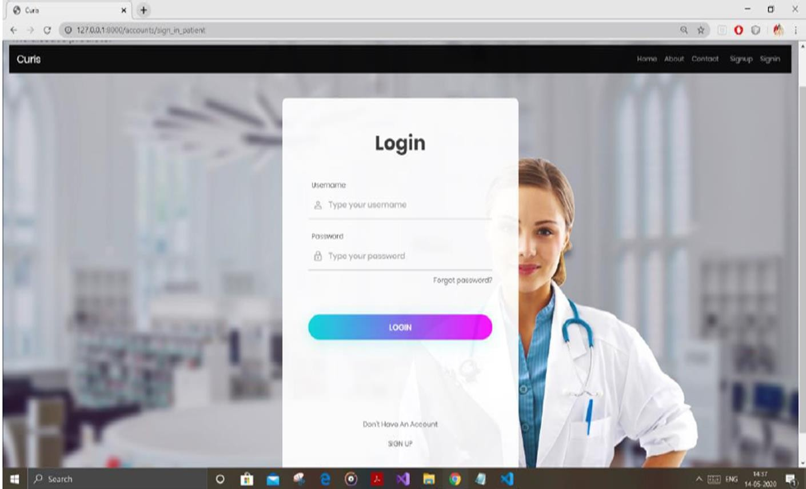
FIG: PATIENT LOGIN PAGE

Slide 29
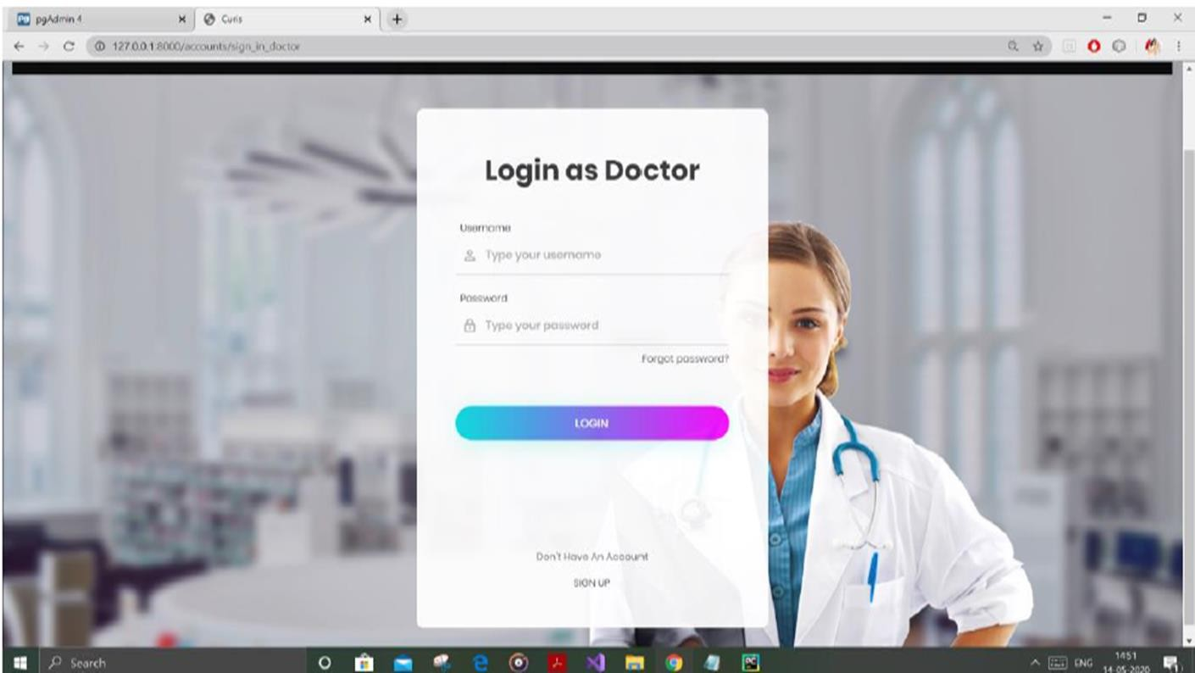
FIG: DOCTOR LOGIN PAGE

Slide 30
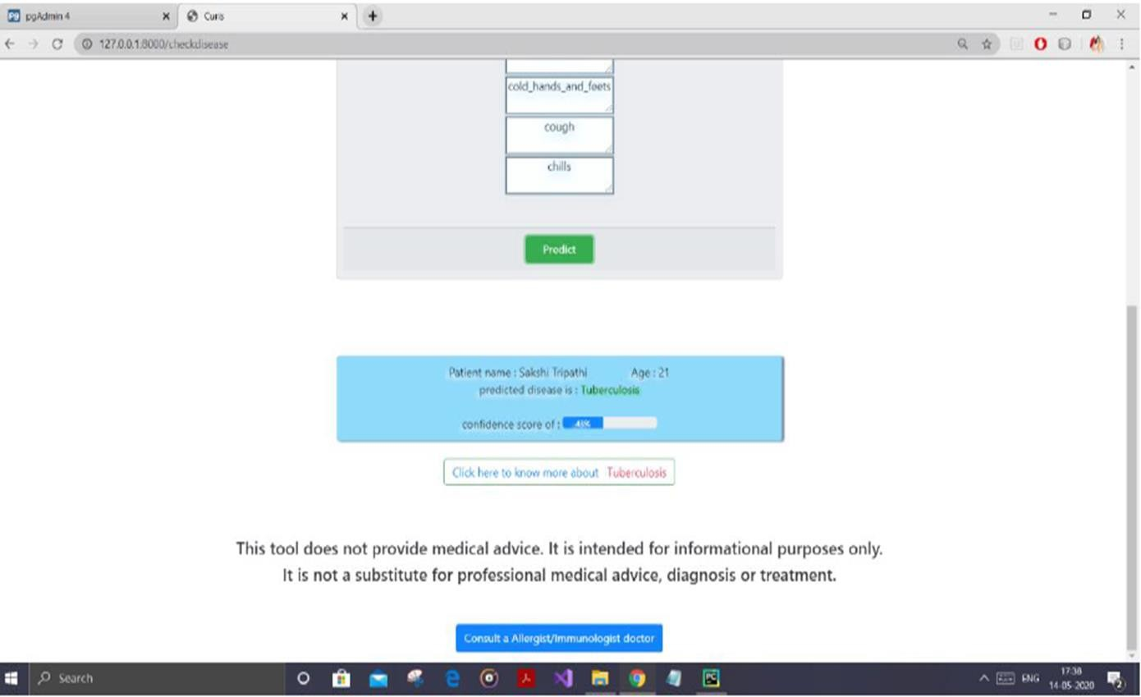
FIG: PREDICTION PAGE

Slide 31
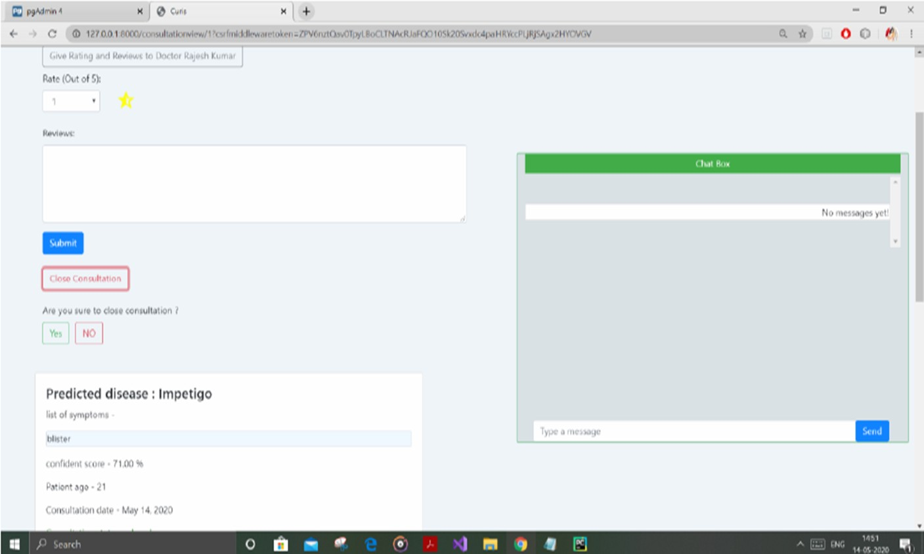
FIG:CONSULTATION PAGE

Slide 32
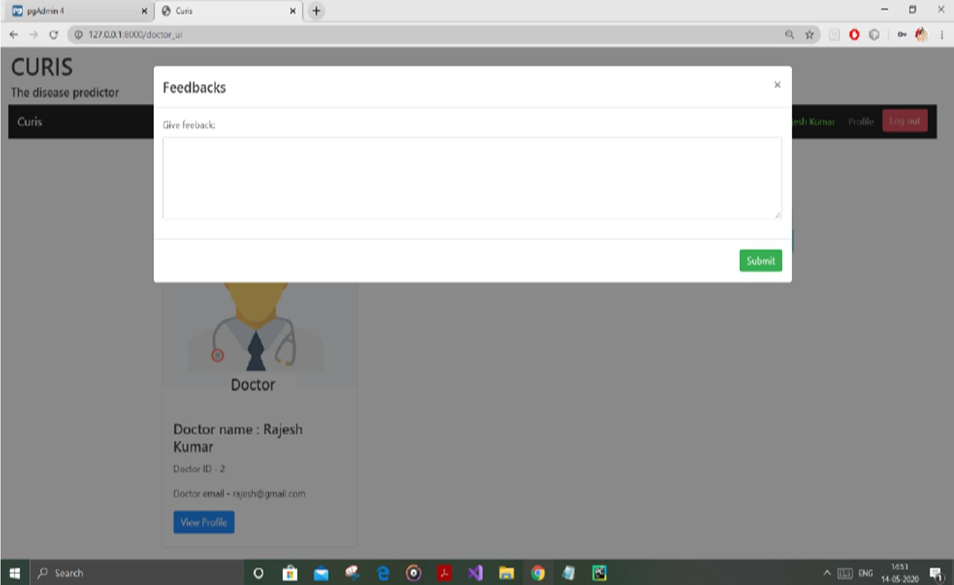
FIG: FEEDBACK PAGE

Slide 33
CONCLUSION
Developing a prediction system using Machine learning, will be one of the reasons for technology to be closer to the patients and doctors, who can diagnose their disease by their symptoms and healthcare professionals can analyze the disease in better manner respectively. To bridge the gap between doctors and patients which will help both classes of users in achieving their goals.

Slide 34
REFERENCES
A. Gavhane, G. Kokkula, I. Pandya, and K. Devadkar, “Prediction of heart disease using machine learning,” in 2018 Second International Conference on Electronics, Communication and Aerospace Technology (ICECA), 2018, pp. 1275–1278.
P. S. Kohli and S. Arora, “Application of machine learning in disease prediction,” in 2018 4th International Conference on Computing Communication and Automation (ICCCA), 2018
A. K. Dwivedi, “Performance evaluation of different machine learning techniques for prediction of heart disease,” Neural Computing and Applications, vol. 29, no. 10, pp. 685–693, 2018.
N. Lavesson, Evaluation and Analysis of Supervised Learning Algorithms and Classifiers, 2006.

Slide 35
THANK YOU

